Slide 1
Governance Examples and Practices
Mandy Chessell

Slide 2
Introduction
Governance and information/data management is a big space and can be broken down in many ways.
Use the contents of the deck as ideas to build on the model you have.
Content
Data Strategy
Multi-faceted Governance
Designing Governance
Governance Definitions
Information supply chain design
Maturity model
Data models and metadata
ODPi Egeria

Slide 3
Coco Pharmaceuticals persona
https://odpi.github.io/data-governance/coco-pharmaceuticals/personas/

Slide 4
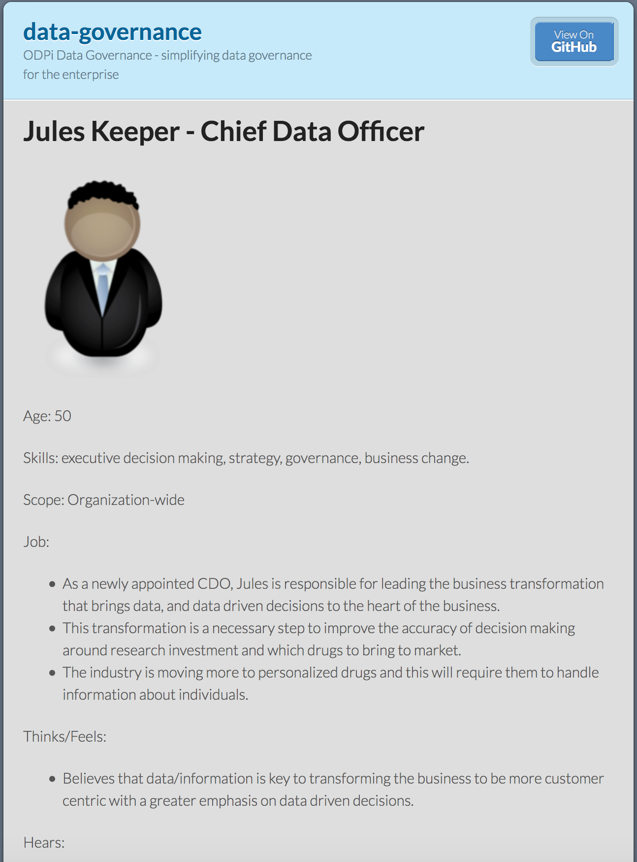
Coco Pharmaceuticals persona
https://odpi.github.io/data-governance/coco-pharmaceuticals/personas/

Slide 5
Data Strategy
Mandy Chessell

Slide 6
Data Strategy
The fundamental question behind any data strategy is:
How can data assist the organization in delivering its business strategy?
The business strategy may be to move into a new geography, radically change its operations to meet competitive challenges or to develop a new product line.
Whatever the direction of the business strategy, there is always an element of internal business transformation and a need for information about the new opportunity that the business strategy embraces.

Slide 7
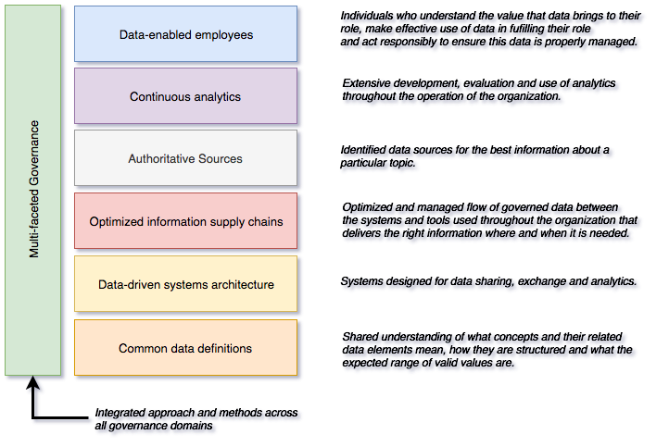
Data Strategy Framework (example)
Each box represents an area of focus and investment.
They can be led by different teams and can each deliver concrete business value.

Slide 8
Structure of a governance program
Data strategy = governance strategy for data governance domain
Business
Imperatives
Threats
Regulations
Governance
Principles
Governance
Obligations
Governance
Approaches
Technical Controls
Classifications
Organizational Controls
Project
Project
Project
Project

Slide 9
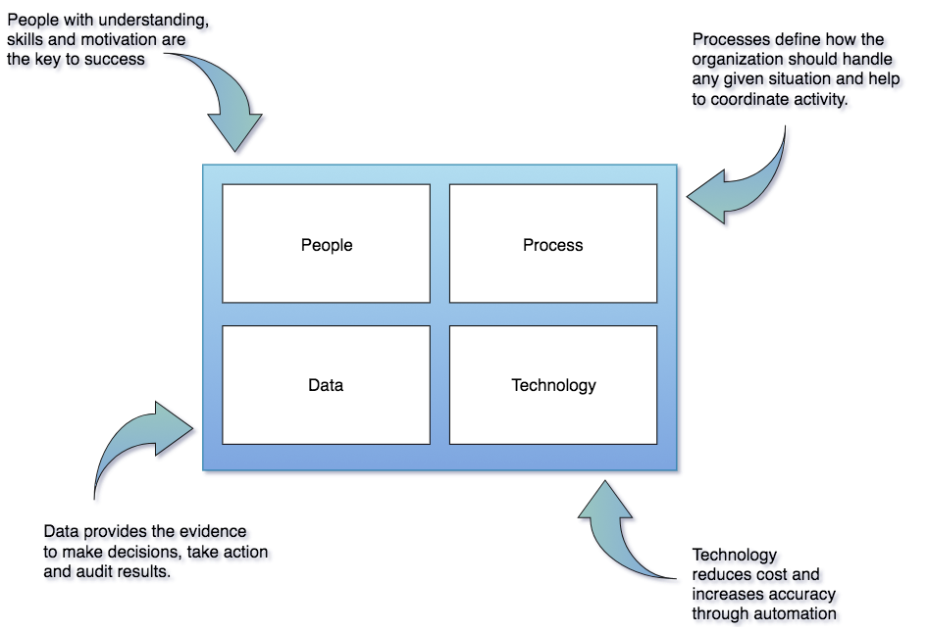
Governance program components
Notes:
Governance needs to be designed for the individual and scaled to the organization.
Successful Information Governance is implemented with a combination of:
Skilled people, correct roles and organization
Processes that create a pragmatic, targeted and agile work environment.
Standards, templates and assets that improve consistency between implementations.
Technology that automates classification, enforcement validation, and correction of data.

Slide 10
Three interlocking lifecycles of governance
Policy
Program
Office
Audit
Define
Monitor
Policy
Roll out
Classify
Operations
Policy
Metadata
Development
Design
Execute
Deploy
Detect
Remediate
Develop

Slide 11
Three interlocking lifecycles of data/information governance
Policy
Program
Office
Audit
Define
Managing policies, rules and classifications.
Monitor
Policy
Roll out
Classify
Operations
Policy
Metadata
Development
Design
Managing and curating information sources and business terms
Execute
Managing common information models and related rule implementations.
Deploy
Detect
Remediate
Develop

Slide 12
Governance Program Office
Strategize
Design
Implement
Review

Slide 13
Governance Program Office Activity Types
Governance Activity Type | Information Exchange | Role that technology can play
Communication | Policies & Metrics | Delivering education, best practices, assessments, templates.
Compliance | Design Changes | Implementing control points and execution points. Support for design and code reviews. Test Data Management.
Exception | Exception Requests | Exception process management, incident reporting.
Feedback | Measurements | Dashboards and reports on compliance.
Vitality | New Requirements | Change process management

Slide 14
Multi-faceted Governance
Mandy Chessell, IBM

Slide 15
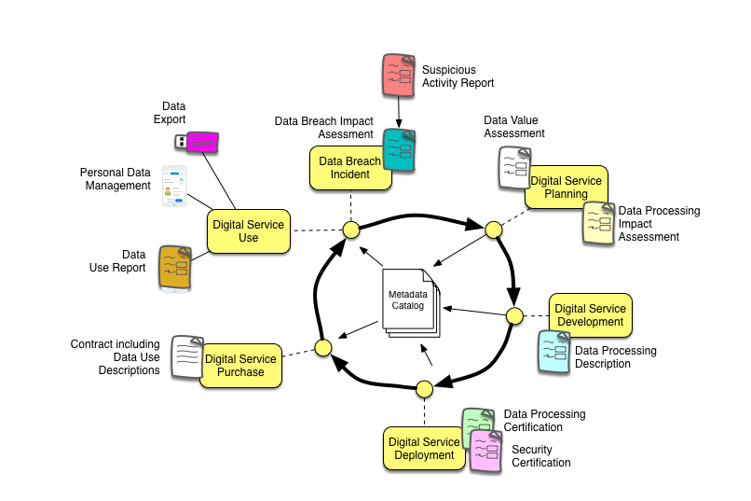
Digital Service Lifecycle

Slide 16
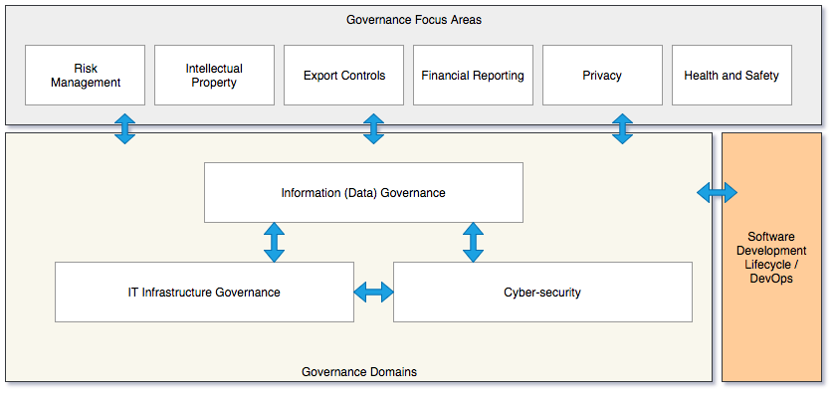
Governance in the enterprise
Minimal - need agreements on obligations and delegations
Ideal - shared tools, approaches with regular collaboration

Slide 17
Designing Governance
Mandy Chessell, IBM

Slide 18
Example: Supporting the Use of Authoritative Sources
Definitions of authoritative sources and where they are used.
Control Points in Sprint and Design Review Processes
Make it Visible
Make it Clear
Definitions of policies, rules and processes around the use of authoritative sources
Pre-built data structures implementing standards.
Make it Unavoidable
Make it Easy to do the right thing
Data refinery services for common re-engineering tasks.
Enforcement in build, automated test cases and configuration management
Easy access to compliant test data.

Slide 19
Setting Up a Governance Program
Information governance should start small and focus on the most important information, and then expand out as it demonstrates its worth.
It must evolve with the business, be responsive and accountable, while seeking to communicate and educate people in the appropriate management of information.
Most important, it needs senior stakeholders and visible consequences for those who ignore the requirements.

Slide 20
Critical Success Factors
Cost-effective
Use of automation: particularly around the classification and characterization of information, along with the detection and notification of issues.
Focus: ensuring that the governance program focuses on the most valuable information and applies action where the greatest impact is felt.
Adaptable
Measurable
Understandable
Unavoidable

Slide 21
Key roles and responsibilities
Organized by:
Subject area
Business unit
Data
Officer
Regulator
Executive
Manager
Asset
Owner
Asset
Consumer
System
Administrator
Security
Officer
Incident
Owner
Data
Steward
Data
Custodian
Advocate
Customer
Supplier
Project
Lead
Developer
Privacy
Officer
Data
Subject
Subject Area
Owner
Architect
Notes:
https://github.com/odpi/data-governance/tree/master/docs/roles

Slide 22




Personas verses Roles
Tessa Tube
Lead Researcher
Within and organization people perform multiple roles related to their core specialism.
<Persona>
<Roles>
Roles are contextual.
When is comes to working with data, the role they are playing is related to the task they are performing and the data asset they are working with.
Researcher
System
Owner
Asset
Consumer

Slide 23
Scope of responsibilities
Data Sources
Data Lake
Data Source
Stewards
Data Consolidation
Stewards
Data Project
Stewards

Slide 24
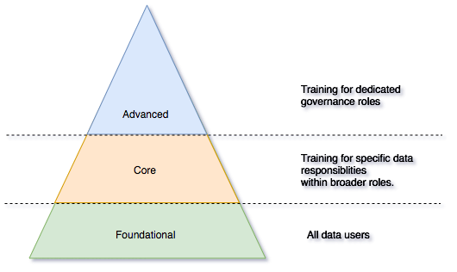
Education and Practice
Job design
Training
Measurement
Rewards and advancement

Slide 25
Governance Definitions
Mandy Chessell, IBM

Slide 26
Governance Policies
The governance policies are divided into three main groups:
Principles: Information governance principles define the high-level goals and approaches of the information governance program. They are defined by the program leaders and provide the terms of reference for all decisions made as part of the information governance program.
Obligations: Obligations define policies that have been delegated from other governance focus areas and domains. The information governance program supports not just the implementation of obligations, but also provides the mechanisms for measuring compliance, reporting exceptions and supporting auditing in the terms of the delegated policies.
Approaches: Approaches describe the standards that have been adopted by the information governance program to increase consistency and remove unnecessary mapping between different implementations.
They may be implemented within the governance program or delegated to another program (eg security)

Slide 27
Establishing Governance Principles As the CDO, Jules first establishes the top-level governance policies. These are called the governance principles since they underpin all other governance decisions.
Information consumers are responsible. Individuals are responsible for safeguarding the information that they own, access and use.
Decision makers are responsible for ensuring they are using information of appropriate integrity for their work.
Information is kept as long as it is needed. Information that is no longer needed will be disposed of appropriately.
Information is protected. Information is secured from unauthorized access and use.
Information quality is everyone’s responsibility. Information is validated and where necessary it is corrected and made complete.
Information is managed in a cost effective manner. This is achieved through a well-defined information architecture that follows standards and best practices.
Information and analytics will be only be used for approved, ethical purposes.
The principles are defined as follows:
Information is a company asset. It will be managed according to the prescribed governance policies.
Information is identified and classified. All information stored by the company will be identified and classified according to its sensitivity and content. This classification will determine how the information will be governed.
Information is a sharable resource and should be made available for all legitimate needs of the company.
Information is owned. There is an individual responsible for the appropriate management and governance of each information collection.
Information consumers are identified. An individual will be identified and be accountable for each access and change they make to information.

Slide 28
Approaches
The information governance approaches define the approved standards, best practices and architecture that under-pins the information governance program.
Standards for data structures and definitions
Standards for reference data
Standards for authoritative sources
Standards for protection of information
Standards for retention and disposal of information
Standards for managing information quality

Slide 29
Organizations expect information governance will deliver …
Understanding of the information they have,
Confidence to share and reuse information,
Protection from unauthorised use of information,
Monitoring of activity around the information,
Implementation of key business processes that manage information,
Tracking the provenance of information and
Management of the growth and distribution of their information.

Slide 30
Policy support inside the Governance Catalogue
Principle
Classification
Principle
Policy
Actioned by
Metadata
Description
Policy
Principle
Definition
Governance Rule
Governs
Classification
Classified by
Implications
Implications
Implications
Implemented by
Describes
Governance Rule Implementations
Governance Rule Implementations
Rule Implementation
Information Resource
Deployed to, Executed by,
Monitored by

Slide 31
Classification Schemes
Classification is at the heart of information governance. It characterizes the type, value and cost of information, or the mechanism that manage it. The design of the classification schemes is key to controlling the cost and effectiveness of the information governance program.
Business Classifications
Business classifications characterize information from a business perspective. This captures its value, how it is used, and the impact to the business if it is misused.
Role Classifications
Role classifications characterize the relationship that an individual has to a particular kind of data.
Resource Classifications
Resource classifications characterize the capability of the IT infrastructure that supports the management of information. A resource's capability is partly due to its innate functions and partly controlled by the way it has been configured.
Activity Classifications
Activity classifications help to characterize procedures, actions and automated processes.
Semantic Mapping
Semantic mapping identifies the meaning of an information element. The classification scheme is a glossary of concepts from relevant subject areas. These glossaries are industry specific and they are shipped with our industry models. The semantic classifications are defined at two levels:
Subject area mapping
Business term mapping

Slide 32
Implementing Policies – through rules and classifications
A policy is a description of business intent for a class of assets to adhere to a certain behaviour.
What are we trying to achieve
Example -
A rule defines how data of a particular classification will be governed in a specific situation – it is the policy response.
A rule has a logical definition and one or more implementations

Slide 33
Architectural Sketch of Operational Governance Ecosystem
Look up
Governance Team UI
Policies and
Regulations
Report
Dashboard
Catalog
Workflow
Query
Policy
Steward’s Tasks
✓
Task
Compliance
& Risk reports
Task
Task
Development Tool
Rule
Description
Data Mart
Action
Implementation
Stewardship
Process
Report
Control Point
Measurements
Link to
Control
Point
Deploy
Stewardship
Measurements
Classification
Governance-Aware
Runtime
Execution Point
Triage Process
Resource
Description
Look up
Verification
Report
Exception
Report
Exception
Measurements
Exception
Enforcement
Report
Enforcement
Measurements
Resources
Resources
Describe
Resources

Slide 34
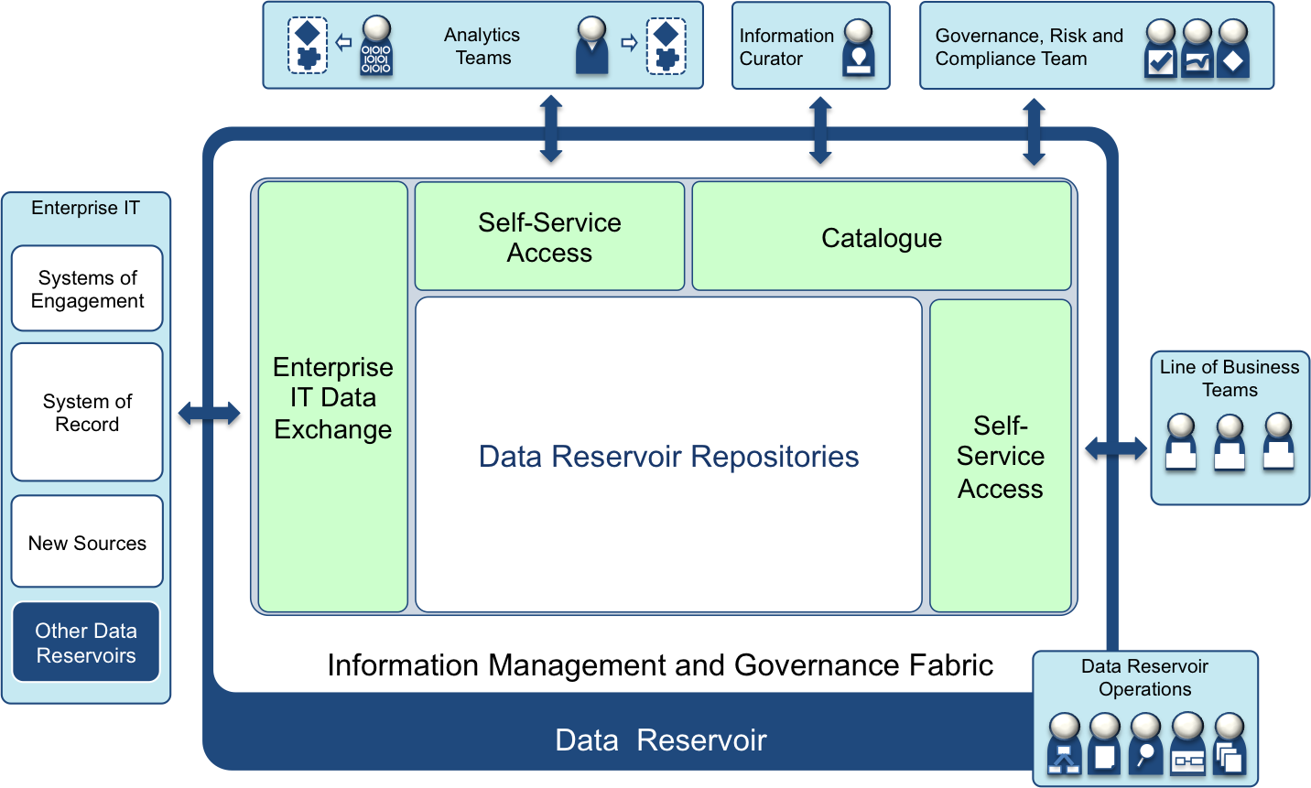
Governance Rules Defined for each classification for each situation
Sensitive information masked here
Personal information masked here
Personal information masked here

Slide 35
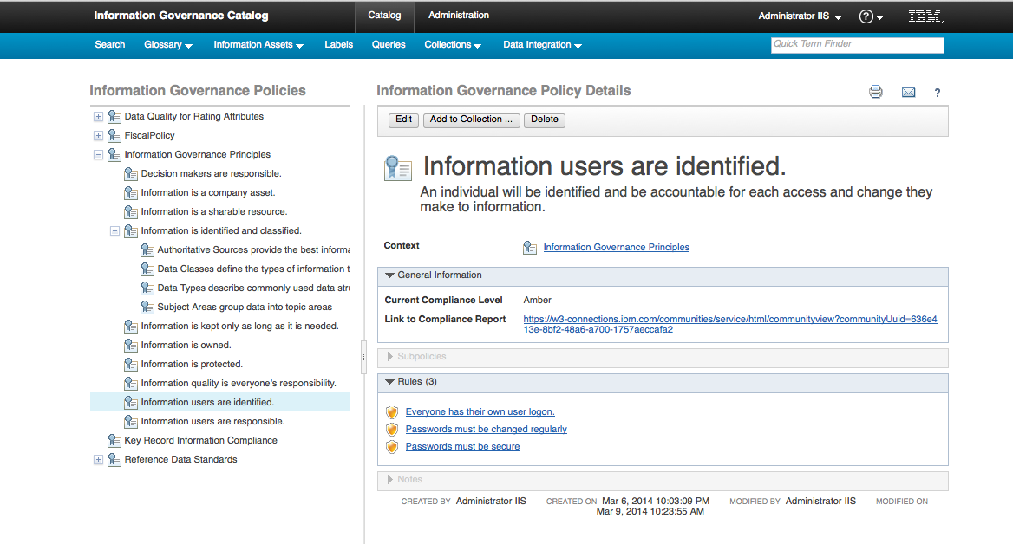
Monitoring Policies and Auditing
Information governance catalogue data is available through SQL Views to enable reporting on compliance.
Information Virtualization
Policies
KPIs Data Mart
Exception DB

Slide 36
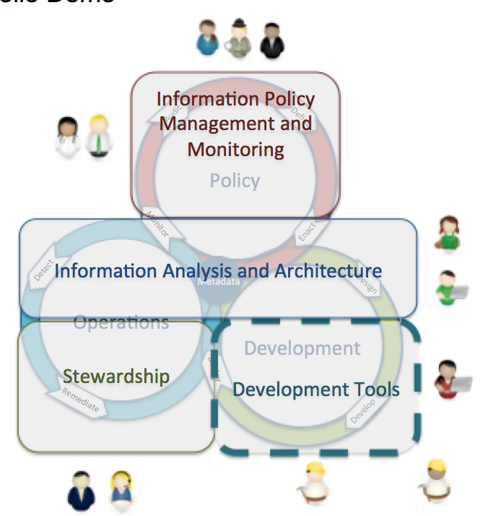
Setting up and monitoring policies - summary
(1) Jules Keeper establishes a set of information governance principles
(2) Jules works with Ivor Padlock (Security) and Faith Keeper (Auditor) to expand the definitions of the principles to cover the security and audit requirements around information.
(8) The summaries of the rules execution and exceptions detected are recorded for Jules to review. He is looking for continual improvement. He reviews the results with Erin and they plan further improvements.
(3) Each of the information owners, such as Tom Tally (Accounts Manager) and Tessa Tube (Lead Researcher) work with Jules and Erin Overview (Information Architect) to consider how these principles should be implemented for their information.
They flesh out more detailed policies and rules that they will follow. Again these are documented in the Governance catalog.
(4) Erin and Peter Profile (Information Analyst) ensure information is classified correctly so they are assigned to the correct policies and rules. The classification involves creating a basic definition to the information sources and classifying them according to their content.
(5) For important sources, Peter uses the survey framework is used to initiate deeper analysis of the information sources. He sets this analysis up to run over night when the load on the systems is low.
(6) Erin asks Polly Tasker (IT Project Manager) to get her team to implement some new quality rules and exception management capability to support the program.
(7) Individuals are given responsibility for correcting errors that are found in particular types of data. For example, Harry Hopeful (Sales) becomes responsible for data about his customers. He is notified when issues are discovered and he must fix them as soon as possible.

Slide 37
Information Supply Chain Design
Mandy Chessell, IBM

Slide 38
Analysis of an information supply chain

Slide 39
The Custodian Ownership Model
The custodian model states that the responsibility for data quality is with the owner of the system where it resides.
When data passes from one system to another, the source owner is responsible for supplying high quality data, but once it is stored in the target system then the owner of the target system is now responsible for the data quality of the received values.
In the picture, each of the areas in the grid is a different zone and the systems within each zone have their own team managing the information.
The crossing points of the connections between the systems is where the responsibility is passed to the next team.

Slide 40
Information Supply Chain
The end to end flow of a particular type of data.
Operational Systems
Data Lake
Governance Catalog (Metadata)
Optimized to improve timeliness, remove inconsistencies, reduce cost
Discovered through governance metadata …

Slide 41
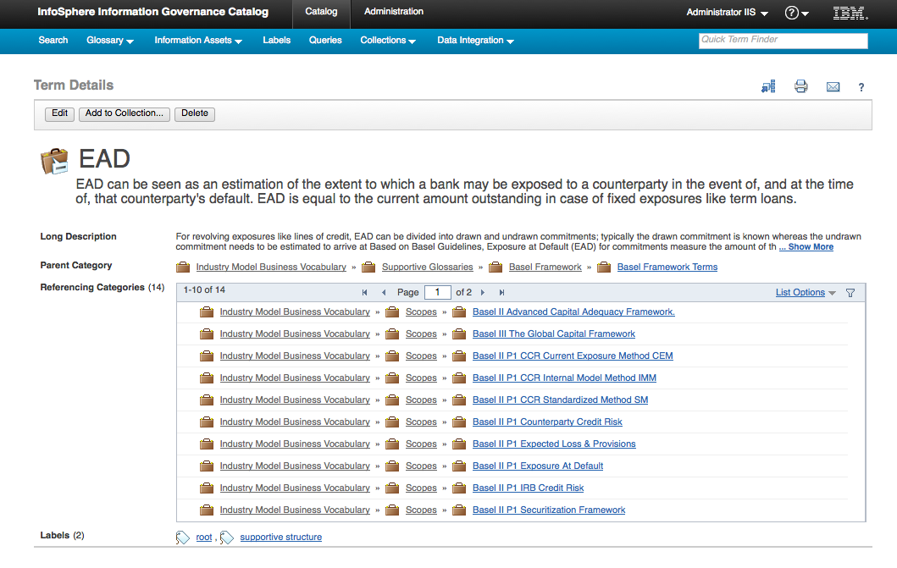
Glossary Terms
Shows the meaning of a field and where it is stored or processed.
Operational Systems
Data Lake
?
Governance Catalog
(Metadata)

Slide 42
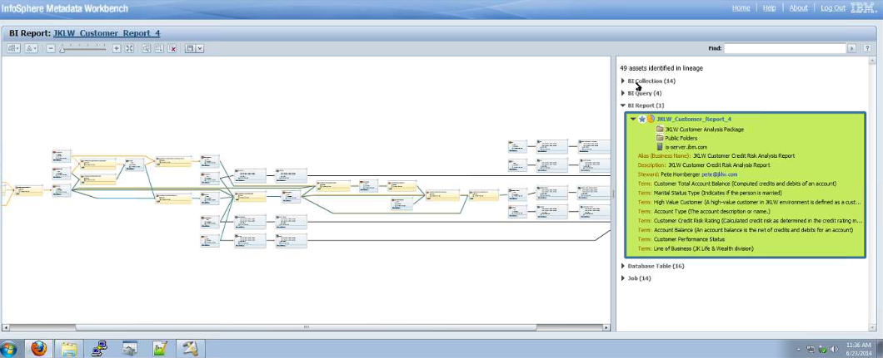
Lineage
Shows the flow of data to or from an asset.
Operational Systems
Data Lake
?
Governance Catalog
(Metadata)

Slide 43
Maturity Model
Mandy Chessell, IBM

Slide 44
Governance maturity seen in terms of Value and Scope

Slide 45
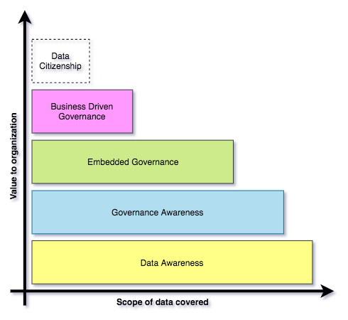
Building governance maturity is a gradual process
Organizations may operate different levels of maturity in different parts of their business.
Choices determined by where the most value lies.
Many organizations aspire to provide all employees with the data they need (data citizenship*)

Slide 46
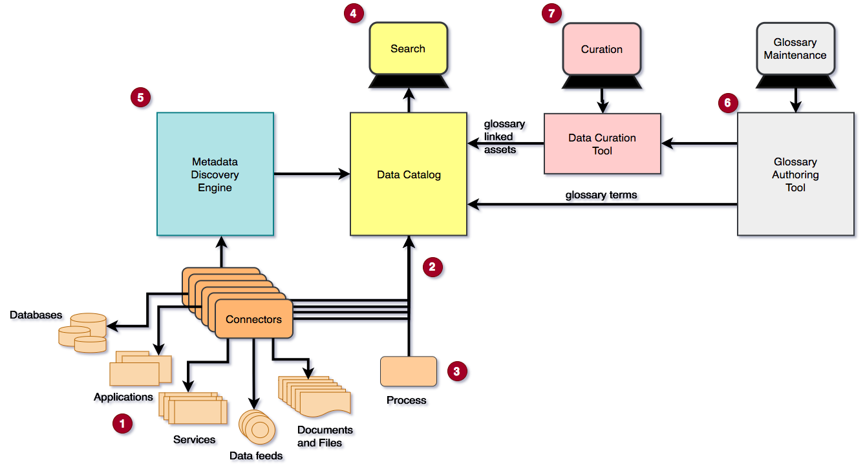
Implementing Data Awareness

Slide 47
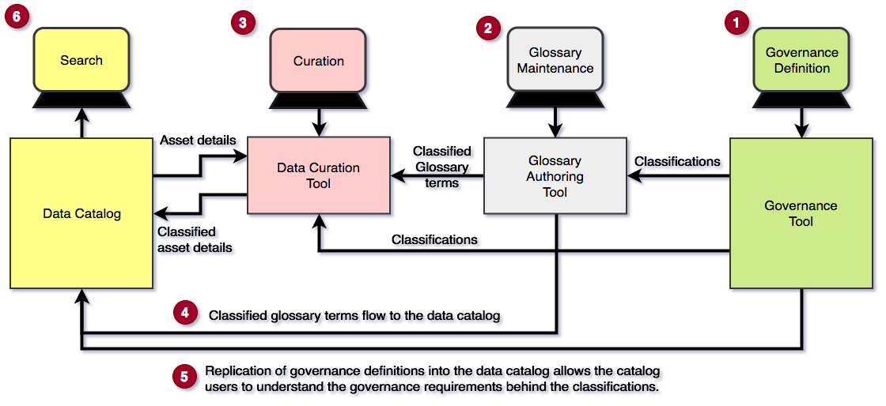
Implementing Governance Awareness

Slide 48
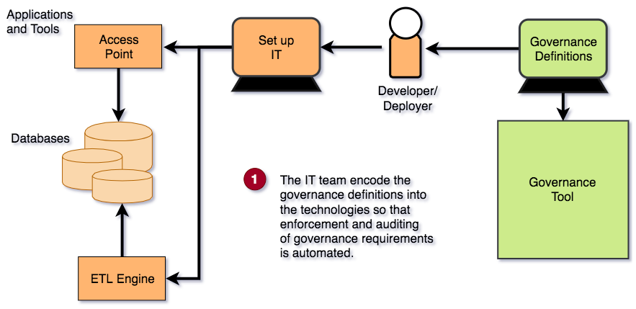
Implementing Embedded Governance

Slide 49
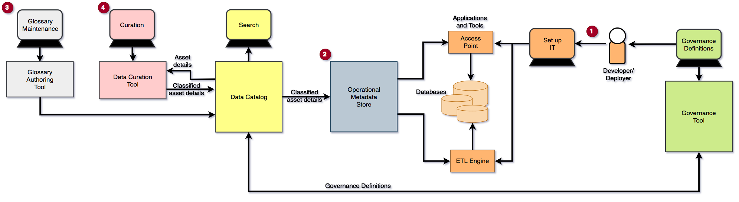
Implementing Business Driven Governance

Slide 50
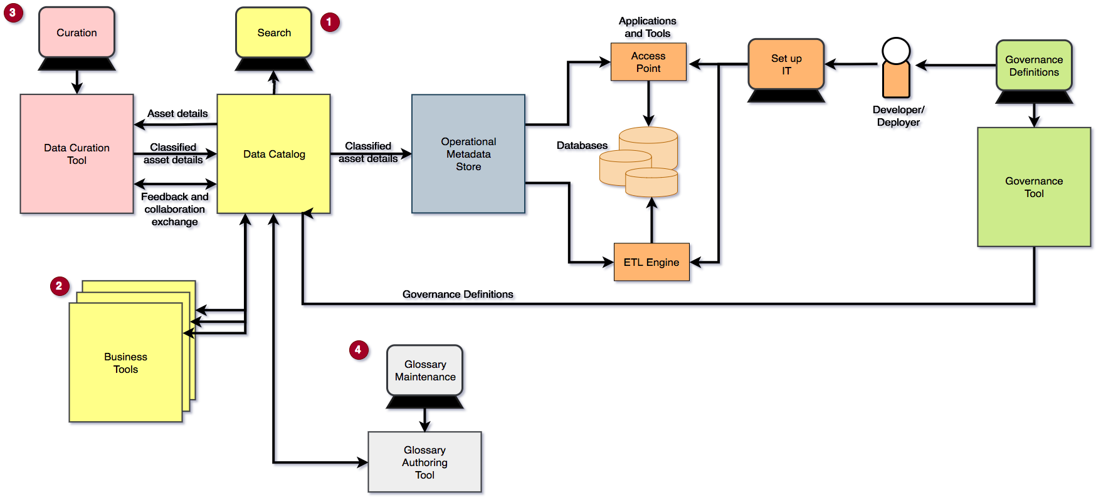
Implementing Data Citizenship

Slide 51
Observations from the maturity model
The number of bespoke integrations between tools to exchange metadata so it is consistently available to everyone who needs it grows steadily with each step up in maturity.
With little to no standardization between vendors, the cost and time delay is born by the organization.

Slide 52
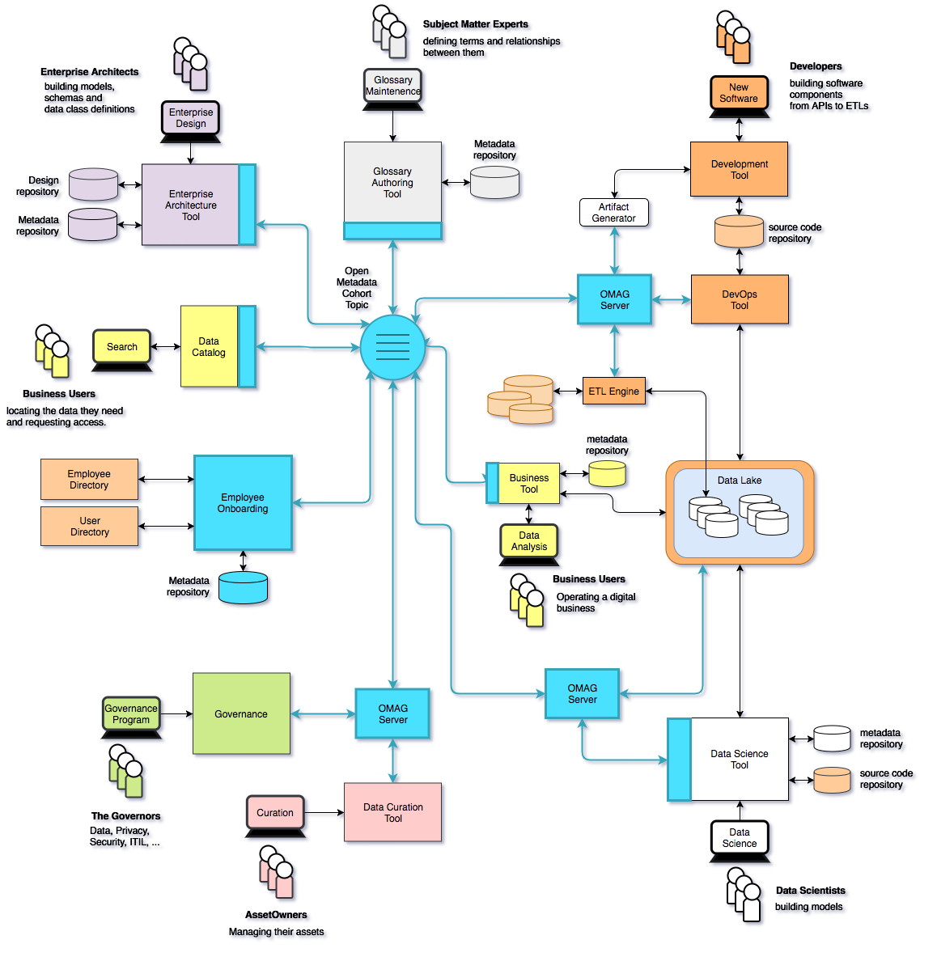
Using Egeria …
Eases the cost of metadata integration through
Comprehensive standards and libraries.
Active vendor recruitment program.
Provides direct support to many governance roles, filling the gaps between function offered through commercial tools.

Slide 53
Data Models and Metadata
Mandy Chessell, IBM

Slide 54
Scope of metadata for a governance program
Strategy
4
Subject Area Definition
1
Teaming Metadata
(people profiles, communities, projects,
notebooks, …)
Policy Metadata (Principles, Regulations, Standards, Approaches, Rule Specifications, Roles and Metrics)
Business Objects and Relationships, Taxonomies and Ontologies
Augmentation
3
Organization
Feedback Metadata
(tags, comments, ratings, …)
Rollout
Classification
Business Attributes
Campaigns and Projects
Classification Schemes
Implementation
Mapping
Governance Actions and Processes
Rights
Management
Models and Schemas
2
Asset Collections
(Sets, Typed Sets, Type Organized Sets)
Reference Data
5
Instrument
7
Information Process
Instrumentation (design lineage)
Association
Information Views
Augmentation
Discovery
Metadata (profile data, technical classification, data classification,
data quality assessment, …)
Physical Asset Descriptions
(Data stores, APIs,
models and components)
0
Basic Types, Infrastructure and Systems
Access
6
Connectors

Slide 55
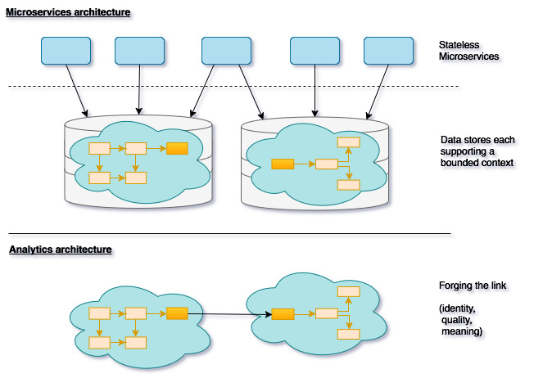
Data flows

Slide 56
Continuum of information transformation
Specific to the individual and task at hand
Information
Event
Information
User
Information
Trigger
Information
Process
Interchange of views
Information Service
Information Collection
Optimized for efficient storage and retrieval for many uses
√

Slide 57
Models for APIs
Model fragments for APIs, data integration and applications.

Slide 58
Models for analytics and databases
Useful for defining how a subject area comes together in a single view

Slide 59
Integrating technologies
Used to relate models from different sources
Linking is via concept – not model to model

Slide 60
Many views of the same concept

Slide 61
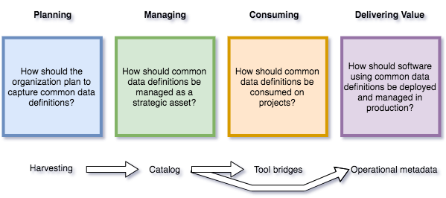
Outline process for common data definitions

Slide 62
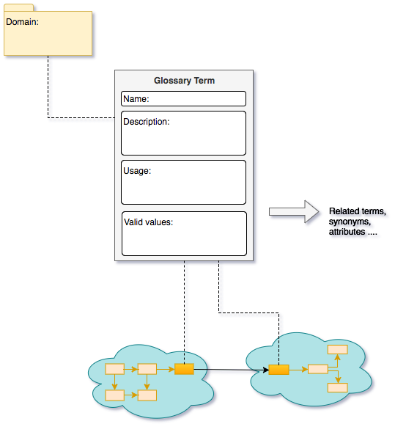
Communication is at the heart of good governance

Slide 63
ODPi Egeria
Mandy Chessell, IBM

Slide 64






Realizing open metadata and governance
Delivering core technology
Recruiting vendors
Assisting practitioners
Core Technology
Vendors
Project
Egeria
Conformance Suite
Practitioners
Best Practices
Project
Data
Governance

Slide 65
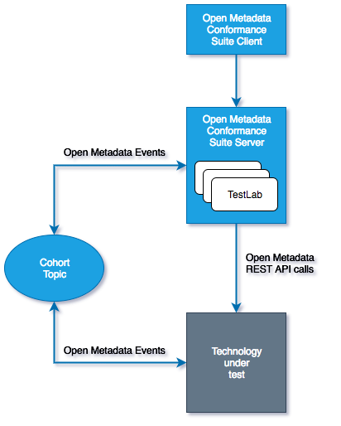

Egeria Conformance Program - its an “imitation game”
Workbench

Slide 66
Open forum
z
z
z
z
z
z
z
Questions?

Slide 67
Links
Press Releases and Podcast
Open source repositories
https://www.linuxfoundation.org/press-release/2018/08/odpi-announces-egeria-for-open-sharing-exchange-and-governance-of-metadata/
https://www.linuxfoundation.org/press-release/2019/02/odpi-announces-new-egeria-conformance-program-to-advance-open-metadata-exchange-between-vendor-tools/
https://roaringelephant.org/2018/09/25/episode-107-open-metadata-and-governance-masterclass-with-mandy-chessell-part-1/
https://roaringelephant.org/2018/10/09/episode-109-open-metadata-and-governance-
masterclass-with-mandy-chessell-part-2/
https://youtu.be/ryd3KFWT1mc
https://github.com/odpi/data-governance
https://github.com/odpi/egeria
67

Slide 68
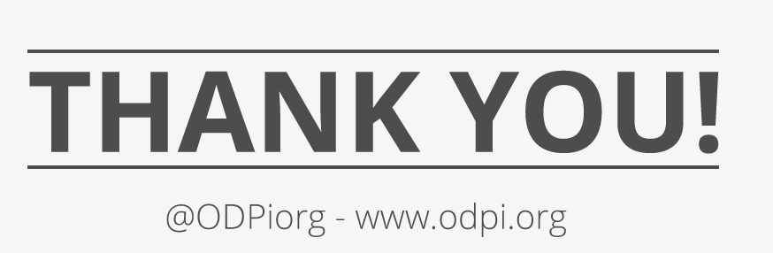
68

Slide 69
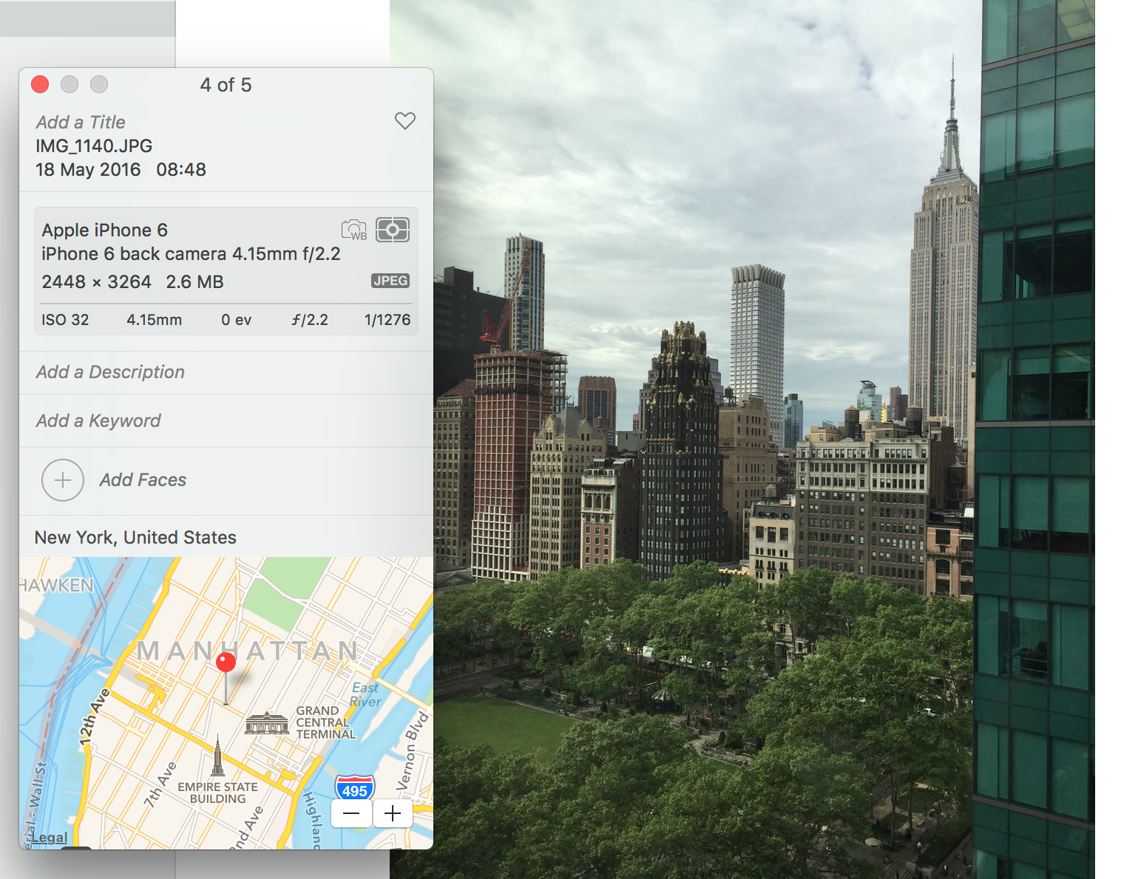
What is metadata?
69
Notes:
AUTOMATED – Metadata is created by application at the same as the data is created in a standard manner easily consumable for all with necessary permissions
Device that took the picture / name of picture / settings picture was taken at / location geo tag of picture etc – all automatic – all done at creation of data time

